Slide 1
Capstone project – Final Presentation
Where should Marco open his desired Burger Joint
Jatin Ajmera for Coursera Capstone Project

Slide 2
Introduction and Business Problem
A customer, Marco, wants to open a new burger joint in Bogota, Colombia
Due to Bogota’s high diversity and very large size, he asked me for help in order to find the best spot to open a burger joint
Bogota has 20 different localities-Districts and we aim to find the best one
We need to find a location with good amount of customers and low amount of competition

Slide 3
Data
To help Marco in his search we need to access the following data
The localities of Bogota, Colombia from Wikipedia
https://es.wikipedia.org/wiki/Anexo:Localidades_de_Bogot%C3%A1
The coordinates (Latitude, Longitude) of these localities of Bogota from open street map APIs
From foursquare we will need following venues data
The burger joint ventures of the localities
The offices venues of the localities
The high school venues of the localities
The universities venues of the localities
We will then leverage the data in order to determine which locality is the most appropriate in order to locate the burger joint

Slide 4
Methodology
For each locality, all office, school, universities and burger joints venues data have been collected from Foursquare.
Then for each locality, the sums of the office, school, universities and burger joints were calculated
For each of this 4 categories, a weight has been defined according to what Marco considers most important
Burger joints have been weighted as -1, since we want to avoid concurrence
Schools have been weighted as 1, since students are good customers
Universities have been weighted as 1.5, since students are good customers
Offices have been weighted as 2, since employees are even better customers
Note that weights can be modified according to importance of each category
Lastly, a score was computed for each locality as the weighted sum of the number of venues in each of the 4 categories(School, university, Offices, Burger joints)

Slide 5
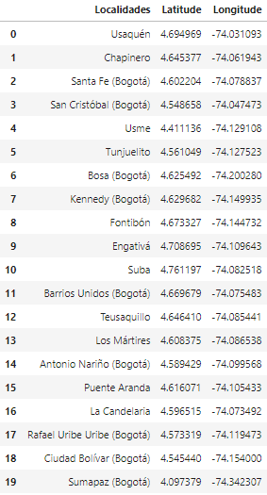
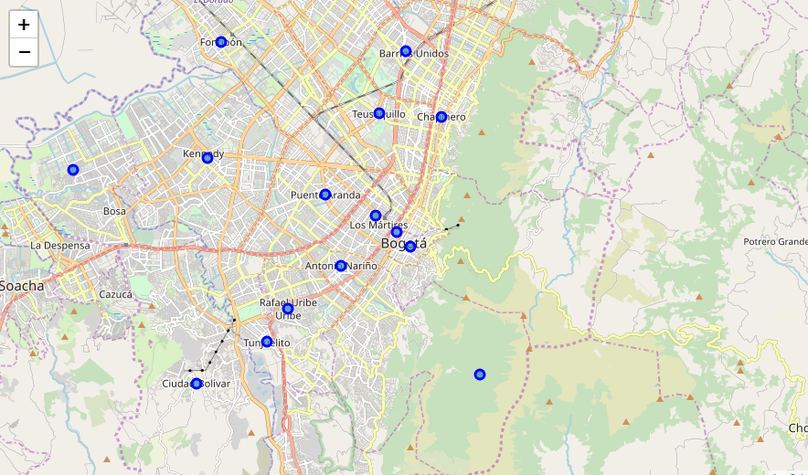
Localities of Bogota, Colombia

Slide 6
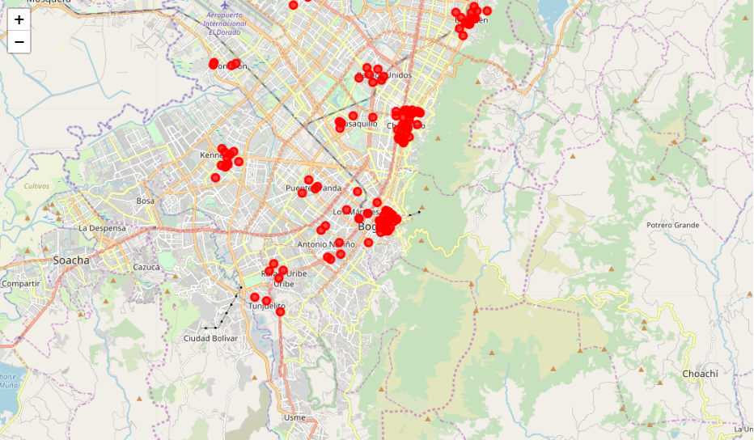
Burger joints in Bogota localities

Slide 7
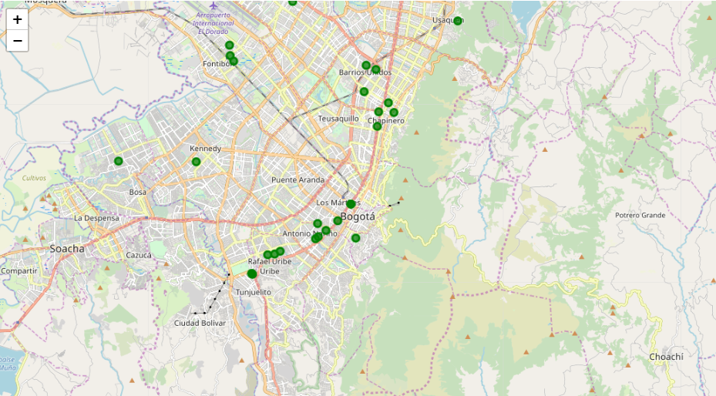
High school in Bogota localities

Slide 8
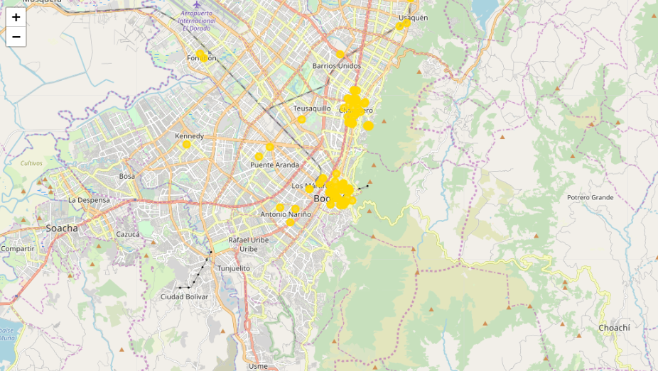
Universities in Bogota localities

Slide 9
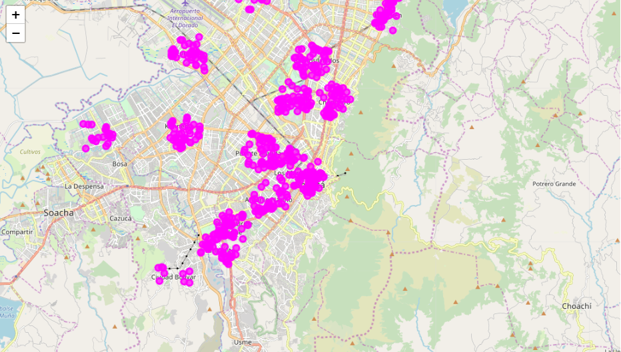
Offices in Bogota localities

Slide 10
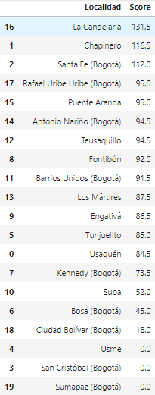
Results
The locality with best score is “La Candelaria” with 131.5, being the best option
Follows closely “Chapinero” with 116.5
These options maximizes the number of potential customers from offices and universities and at the same time have not too large competence.

Slide 11
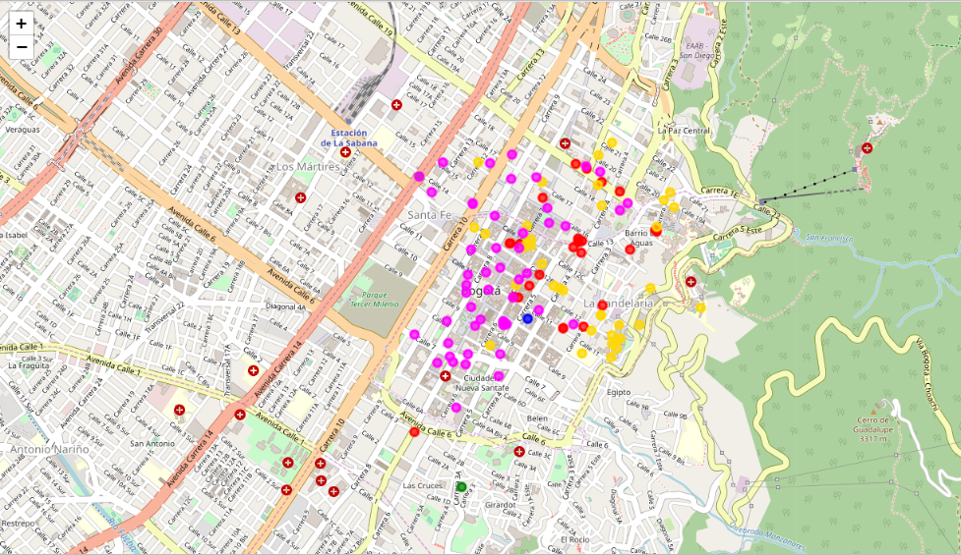
Best place for Burger joint in Bogota is “La Candelaria”

Slide 12
Recommendation
The following analysis can be improved with following extensions:
Consider more categories, For example like “Night life” which is good source for customers. But also like “Restaurants”, which even if not burger joints maybe some concurrence if too many
In the locality itself, it can also be computed the distance between all the venues in order to find a place with the most number of potential customers.
Using smaller geographical areas like neighbourhoods could improve the accuracy for the scores.

